Slide 1
Watson & R
Build with Watson

Slide 2






About Me
Derek Franks
Data Scientist
IBM Market Data Analytics
I’ve been with IBM for 11 years
Primarily work in R
SPSS, Tableau, SAS
github.com/derekfranks
@derek_franks

Slide 3
What is Watson?

Slide 4
Watson can be broken down into two sets of solutions: Offerings and API’s
Offerings
Well developed solutions suitable for bringing directly to clients
Current Offerings:
Watson Engagement Advisor
Watson Explorer
Watson Discovery Advisor
Watson for Oncology
Watson for Clinical Trial Matching
Watson Knowledge Studio
API’s
Tools that can be accessed by developers to build Cognitive Apps
Types of API’s:
Language
Speech
Vision
Data Insights
Source: http://www.ibm.com/smarterplanet/us/en/ibmwatson/?lnk=buwa
Source: http://www.ibm.com/smarterplanet/us/en/ibmwatson/developercloud/services-catalog.html

Slide 5
Language, Speech, Vision and Data Insights are the categories of Watson API’s
IBM currently offers 18 service areas for Cognitive API’s
 | API Service | Description
1 | AlchemyLanguage | AlchemyLanguage is a collection of 12 APIs that enable text analysis through natural language processing
2 | Concept Expansion | Discovers euphemisms and colloquial terms from unstructured text.
3 | Concept Insights | Rather than limiting findings to traditional text matching, Concept Insights explores information based on the concepts behind your input.
4 | Dialog | Create conversations any way you like to answer questions, walk through processes, or just to chat
5 | Document Conversion | Transforms HTML, PDF, and Microsoft Word documents into normalized HTML, plain text, or sets of Answer units that can be used with other Watson services
6 | Language Translation | Identify the language text is written in. Translate text from one language to another for specific domains.
7 | Natural Language Classifier | Interpret natural language and classify it with confidence
8 | Personality Insights | Enables deeper understanding of people's personality characteristics, needs, and values to help engage users on their own terms
9 | Relationship Extraction | Intelligently finds relationships between sentence components (nouns, verbs, subjects, objects, etc.)
10 | Retrieve and Rank | Enhance information retrieval with machine learning
11 | Tone Analyzer | Helps users understand the attitudes that are implied in text
12 | Speech to Text | Low-latency, streaming transcription
13 | Text to Speech | Synthesizes natural-sounding speech from text
14 | AlchemyData News | Query the world's news like a database
15 | Tradeoff Analytics | Helps users make better choices to best meet multiple conflicting goals, combining smart visualization and recommendations for tradeoff exploration
16 | AlchemyVision | Employs deep learning innovations to understand a picture of content and context
17 | Visual Insights | Derive insights from the visual analysis of an image collection by looking at the distribution of automatically recognized semantics
18 | Visual Recognition | Understand the contents of images. Trainable for custom content.
Language
Speech
Data
Insights
Vision
Source: http://www.ibm.com/smarterplanet/us/en/ibmwatson/developercloud/services-catalog.html

Slide 6













Watson Developer Cloud provides developers easy access to cognitive building blocks
What’s the Watson Developer Cloud?
A collection of REST APIs and SDKs that use
cognitive computing to solve complex problems.
Alchemy Language
GA
Concept
Insights
GA
Dialog
GA
Language Translation
GA
Natural
Language
Classifier
GA
Personality
Insights
GA
Retrieve
and Rank
GA
Concept
Expansion
Limited Availability
Relationship
Extraction
BETA
Tone
Analyzer
EXPERIMENTAL
Document Conversion
EXPERIMENTAL
Speech to
Text
GA
Text to
Speech
GA
Alchemy Vision
GA
Visual
Recognition
BETA
Visual
Insights
EXPERIMENTAL
AlchemyData News
GA
Tradeoff
Analytics
GA
Access the site to see the latest additions and updates
ibm.com/WatsonDeveloperCloud
Notes:
The Watson Developer Cloud is a complete, self serve environment for developers with a growing set of Watson cognitive services.
Note: WDC updates on Watson services may occur multiple times per month (additions, Beta to GA transitions, etc.). Please check the site for updates! at IBM.com/WatsonDeveloperCloud
The Watson Developer Cloud environment includes API’s & SDK’s, documentation, demos, sample code, App Gallery, Forum, etc.

Slide 7
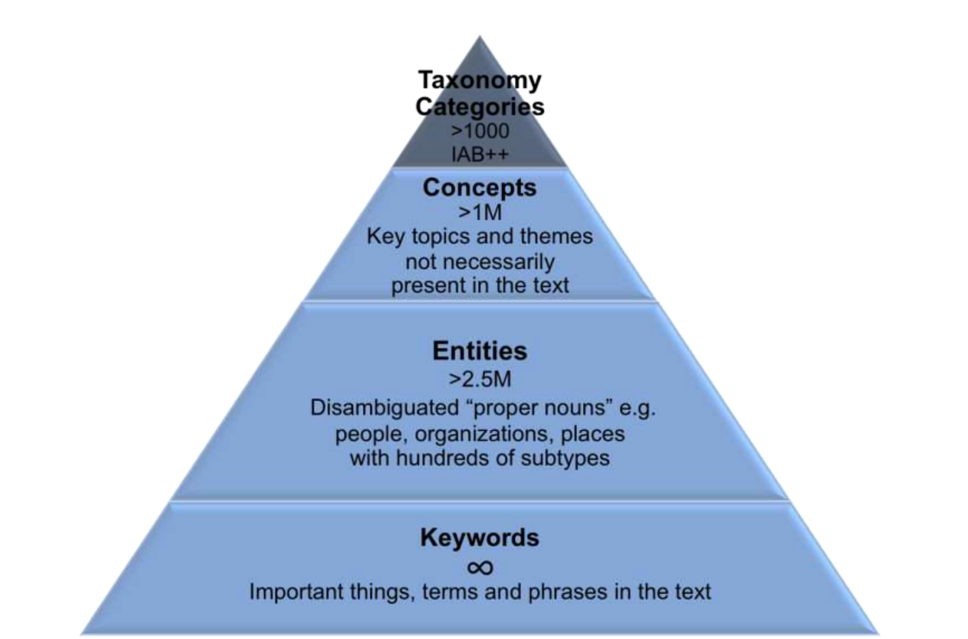
What can AlchemyLanguage extract from unstructured data (text)?

Slide 8
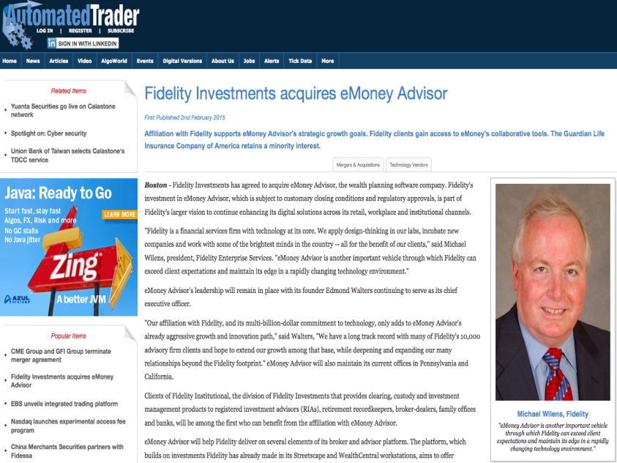
Named Entity Extraction
Extract people, places, organizations, etc. from blogs, news articles and other text.
Examples:
President Obama works at the White House. View Results
Zach Walchuk was born in Mankato, MN and lives in the white house down the street. View Results
View Results

Slide 9
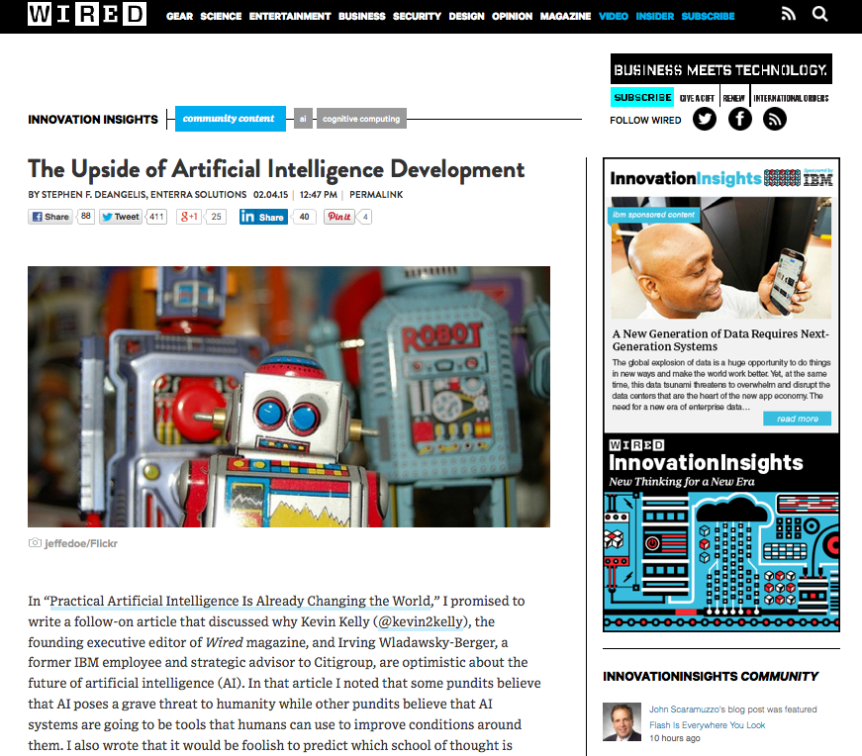
Keyword Extraction
Extract topic keywords, with higher level abstractions via Knowledge Graph.
Examples:
The New England Patriots raised the Lombardi Trophy over the city of Boston on Wednesday. View Results
Keyword extraction is like making a “word cloud” of important words in your document.
View Results

Slide 10
Sentiment Analysis
Extract positive and negative opinions from any text.
Document-level, entity-targeted, and keyword-targeted sentiment mining.
Understands negations, amplifiers, diminishers, typos, hashtags and slang.
Examples:
Overall Text Sentiment
So happy the Patriots won the Super Bowl. Let's party. #PatriotsParade View Results
Targeted Sentiment
So happy the Patriots won the Super Bowl Seahawks suck. #BradyBunch View Results Sea View Results Pats
Run on entities/keywords, if you do not have a specific target in mind.
Overall Text Sentiment
So happy the Patriots won the Super Bowl Seahawks suck. View Results

Slide 11
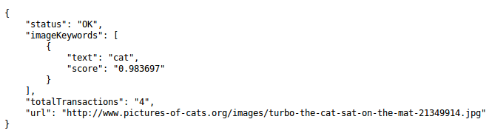


Image Tagging
Extract keywords to categorize your image libraries.
Examples:
View Results

Slide 12

Face Detection
Gather intelligence from images and tag photos with the position, age, gender, and identities of people photos.
Examples:
View Results

Slide 13
Alchemy Language Web App
https://defranks.shinyapps.io/alchemy_shiny/
Upload a .txt file
Concepts
Entities w/ sentiment
Keywords w/sentiment
Download .csv file
Analyze in R, SPSS, Excel, etc

Slide 14
How to get started:
ibm.com/WatsonDeveloperCloud (lets you explore the services)
bluemix.net (get API keys & documentation)
ibm.biz/watsonapps (sample apps)

Slide 15
Let’s jump over to R

Slide 16
Appendix: Watson services

Slide 17
Get started: Explore, Experiment, Build
1
Explore the Watson services
Demos. Concept Videos. Docs. IBM.com/WatsonDeveloperCloud
3
Do the LABS
ibm.biz/node-red-basics Ibm.biz/node-red-alchemy-vision-lab
4
Build Apps
Leverage Sample Code, App Gallery, github…
Join a Hackathon. Ask questions in the Forum.
Try out the APIs free of charge.
Or Speed Development with Coaching
Watson Developer Cloud Enterprise
Onsite training, mentoring, services subscription
Join the Watson Ecosystem
350 partners; 100 in market today
© 2015 International Business Machines Corporation
Notes:
* 5x7 Handout available with short links to developer resources: App Gallery, sample code, Watson Developer Community, a Watson Forum for asking questions, etc.

Slide 18

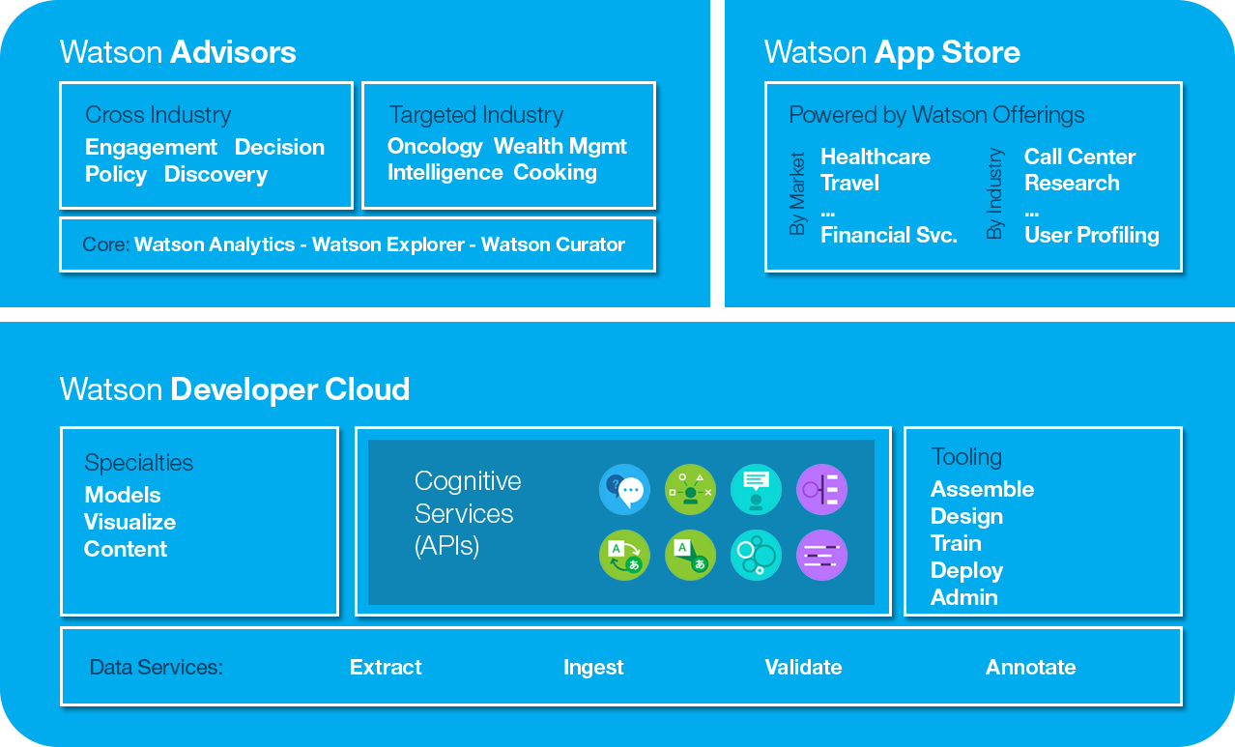
Dialog
What is it?
Walks a user through a step-by-step process in natural, conversational language
Why is it unique?
Keeps track of user conversations, can gather user information and make decisions based on user profile information
How does it work?
Provides a simple, guided experience to get a user to their desired outcome and can kick off back-end application actions as part of the process
Example Use Cases
Decision support / Transaction handling
Question disambiguation / Clarification
Personality & Conversation
•
•
•
•
Notes:
Add link to bluemix page before submitting

Slide 19

Natural Language Classifier - Overview
What is it?
Performs natural language understanding. Turns text into meaning.
Accepts short string of text and is able to classify text into predefined classes
Primary Use Case
Question & answer, classifying Twitter/SMS, sentiment analysis, dialog act classification
Value Proposition
State of the art classifier tailored & tuned for ‘short text
Adjacent Services
Dialog, Speech to Text, Text to Speech

Slide 20

Retrieve and Rank
What is it?
Helps users find relevant information for their query by using a combination of search and machine learning algorithms that detect "signals" in the data
Why is it unique?
Machine learning approach provides superior information retrieval within a vast content repository
How does it work?
Re-ranks search results based on a trained machine learning model
Example Use Cases
Contact Centers in support of Client inquiries
Field technicians troubleshooting a problem
•
•
•
•
Notes:
Add link to bluemix page before submitting

Slide 21
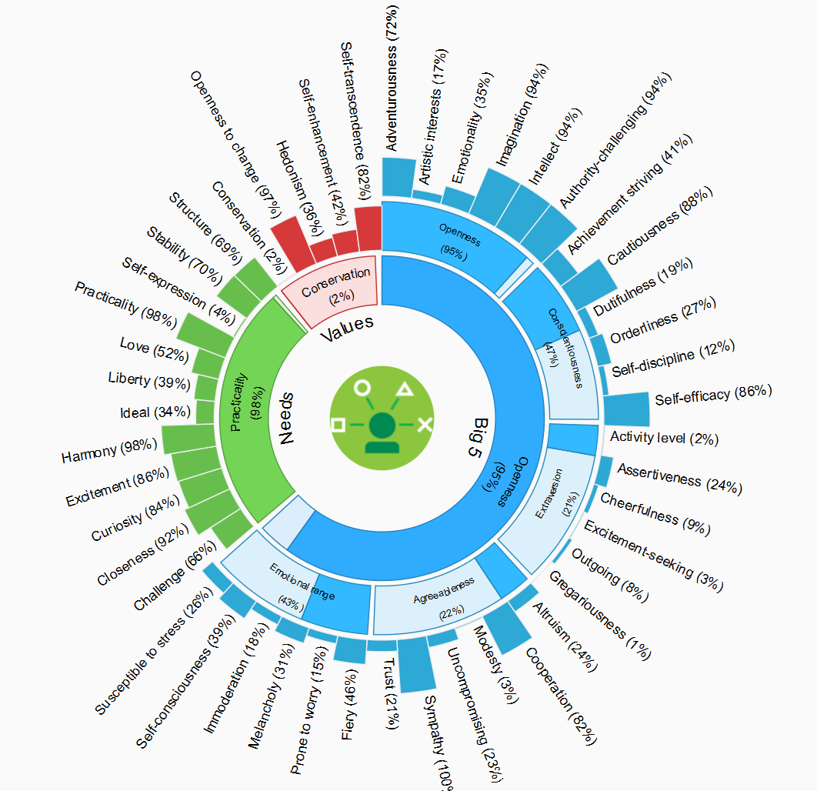
Personality Insights
•
•
•
•
What is it?
Enables deeper understanding of people's personality characteristics, needs, and values to help engage users on their own terms
How does it work?
Extracts a set of personality and social traits based on the way a person communicates.
Example Use Cases
Brand Analytics
Market Segmentation & Campaigns
Customer Care
Notes:
Use Cases
Brand Analytics
Measure the brand personality and compare/contrast with your customers to deliver an actionable recommendations
Market segmentation, Campaign Management, or Promotions
Develop a market segmentation which allows marketers to individualize its campaigns or promotions
Customer Care
Individualize customer care by providing personality traits to drive a 1:1 response
Matching, (Recruitment, University Admission, Love)
Apply individualized traits to match individuals to other individuals, jobs, universities, etc.Watson Personality Insights-Case Studies_v7.pptx
View Case Studies: Watson Personality Insights-Case Studies_v7.pptx

Slide 22
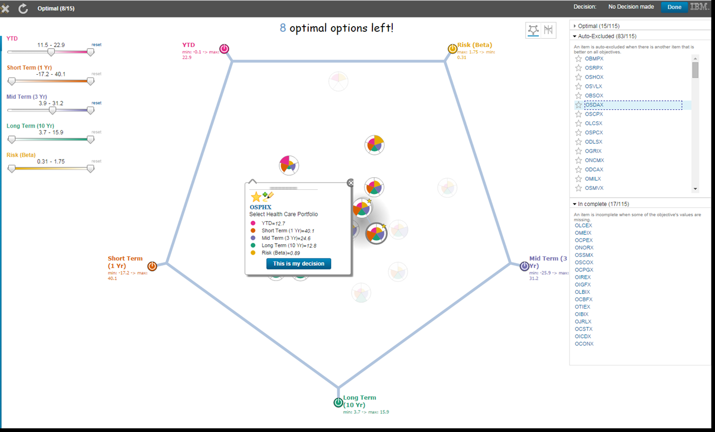
Tradeoff Analytics
What is it?
Helps make better choices under multiple conflicting goals with smart visualizations and analytical recommendations.
How does it work?
Uses Pareto filtering techniques in order to surface only the optimal alternatives across multiple criteria. It then uses various analytical and visual approaches to help the decision maker analyze the tradeoffs.
Use Cases
Enable retailers and manufacturers to determine product mix
Allow consumers to compare and contrast competitive products or services

Slide 23

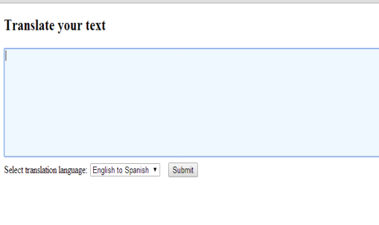

Language Translation
What is it?
High-quality, domain-specific text translation from one language to another. Language Identification (included) identifies the text input language. Model customization enables support for specific translation needs.
Why is it unique?
One of the few offerings that focuses on Domain-specific Statistical Machine Translation
What domains & languages are supported?
The News domain , to translate English to / from French, Spanish, Portuguese, or Arabic
The Conversational domain , to translate English to / from Spanish or Portuguese
The Patent domain, to translate Spanish, Portuguese, Japanese, or Korean to English
Use Case Example
Enables a help desk representative to assist international customers through a chat
Notes:
Alternate Use Case example: A forum administrator wishes to translate user-generated content between English, Spanish, and Portuguese to enable communication between users in the US, UK, and Brazil.
A French speaking help desk representative is assisting a Portuguese speaking customer through a chat session and is able to interact through the translation service
How does it work?
The Language Translation service converts text input in one language into a destination language for the end user. Translation is available among (see domain & languages above)
Announcement blog extract – for June 25 GA
Language Translation enables high-quality, domain-specific translation in the News, Conversational, and Patent domains
Language Translation will now include support for:
Language Identification, to identify which language the textual input was written in
The News domain , to translate English to / from French, Spanish, Portuguese, or Arabic
The Conversational domain , to translate English to / from Spanish or Portuguese
The Patent domain, to translate Spanish, Portuguese, Japanese, or Korean to English
Language Identification (included)
How does it work?
Language Identification detects the language in which text is written. This helps inform next steps such as translation, voice to text, or direct analysis. Today, the service can identify 15 languages – Arabic; Chinese (Simplified); Chinese (Traditional); Cyrillic; Danish; Dutch; English; Farsi; Finnish; French; German; Greek; Hebrew; Hindi; Icelandic; Italian; Japanese; Korean; Norwegian (Bokmal); Norwegian (Nynorsk); Portuguese; Spanish; Swedish; Turkish; Urdu

Slide 24

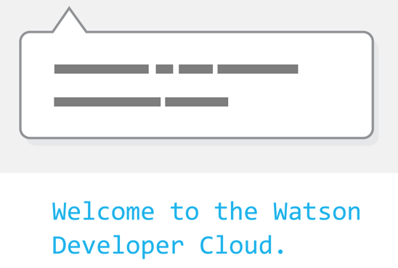
Speech to Text
What is it?
Low-latency, streaming transcription
Why is it unique?
Unique combination of breadth of language support, specific Telephony model support, and ease of contracting and use through Bluemix
What languages and features are supported?
English (US), Spanish, Japanese
Wideband and Telephony models
Metadata (confidence scores, time offsets, alternate hypotheses)
How does it work?
In addition to converting a raw audio signal into a best-guess of the words that are being spoken, intelligence about the relevant grammar / how language is used within a specific context is incorporated to generate a more accurate transcription
Example Use Cases
Call center – recorded audio transcription
Voice-control of devices or applications
Transcription of meetings, lectures and conference calls
Dictation of emails. Mobile apps.
Resources
Blog: IBM Watson announces breakthrough in Conversational Speech
Paper: The IBM 2015 English Conversational Telephone Speech Recognition System
Blog - Initial announcement - IBM Watson now brings cognitive speech capabilities to developers
Discusses the technology behind the capability
Notes:
UPDATED with June release capabilities
Mobile apps can also be included under Use Cases
Example Use Cases
Call center – recorded audio transcription
Voice-control of devices or applications
Transcription of meetings, lectures and conference calls
Dictation of emails. Mobile apps.

Slide 25

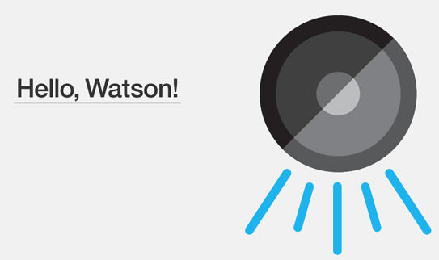
Text to Speech
What is it?
Generates an audio file that has a verbal representation of the input text – complete with appropriate cadence and intonation.
Why is it unique?
One of the most natural-sounding and easy to use APIs on the market.
How does it work?
Converts textual input into speech. Supports:
Multiple voices in US English, UK English, Spanish, French, Italian, and German
A subset of SSML (Speech Synthesis Markup Language)
Improved programming support for applications that reside outside of Bluemix
Example Use Cases
Mobile apps.
Assistance tools for the vision-impaired.
Read texts / emails aloud.
Resources
IBM Watson now brings cognitive speech capabilities to developers
Discusses the technology behind the capability
Notes:
UPDATED with June release capabilities

Slide 26
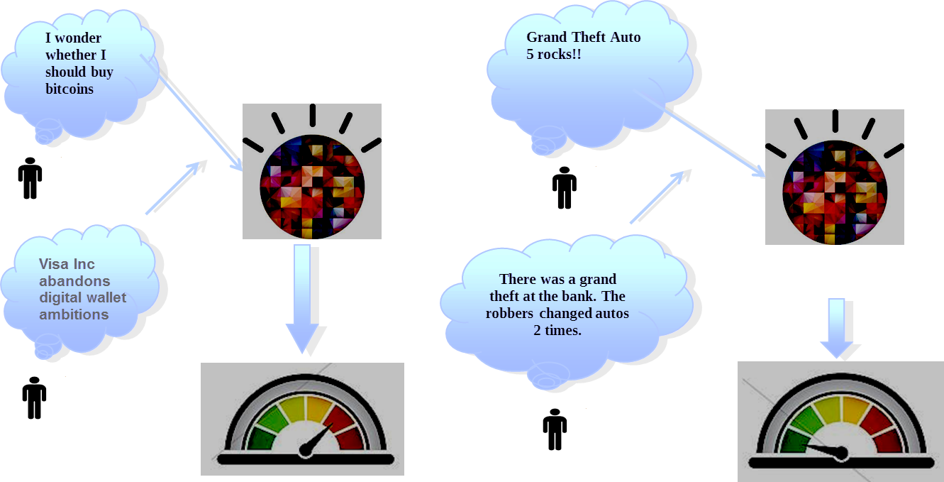
Concept Insights
What is it?
Locate relevant documents that may not directly mention your query.
How does it work?
Maps user-input words to the underlying concepts of those words based on training on English Wikipedia data. The service identifies explicit links when an input document directly mentions a concept, and implicit links when relevant concepts that are not directly mentioned.
Example Use Cases
A legal firm could utilize this service to identify cases which may be related to the case in question
Improve engagement on any external website
Notes:
Alt definition: Explores concepts behind your input, identifying associations beyond traditional text matching

Slide 27

AlchemyLanguage
Entity Extraction
Sentiment Analysis
Keyword Extraction
Concept Tagging
Relationship Extraction
Taxonomy Classification
Author Extraction
Language Detection
Text Extraction
Mircoformats Parsing
Feed Detection
Linked Data Support
What is it?
Twelve APIs for text analysis, each of which uses sophisticated natural language processing techniques to analyze content and add semantic information
How does it work?
Advanced deep learning techniques power web services such as sentiment analysis, entity extraction, keyword extraction, content tagging and more for holistic insights.
Example Use Cases
Content aggregation
Twitter sentiment analysis
Business intelligence
Content discovery
•
•
•
•

Slide 28

AlchemyVision
What is it?
Automatically extract and tag images to understand a picture’s content and context
How does it work?
Uses advanced visual recognition to see complex scenes in their entirety—without needing any textual clues— to understand objects and surroundings
Example Use Cases
Content recommendation
Social media monitoring
Ad targeting
Facial recognition
•
•
•
•
Notes:
Uses advanced visual recognition techniques to see.

Slide 29
AlchemyData News
What is it?
A constantly updating pipeline of content that is crawled, enhanced and stored for consumption – allowing you to query the world’s news like a database in real time.
How does it work?
Aggregates data from a variety of sources, enriches it with natural language processing and stores it for single-query consumption.
Example Use Cases
Signal detection
News alerting
Event detection ("acquisitions")
Trending topics, concepts, people in the news
•
•
•
•
Notes:
What is AlchemyData News API?
AlchemyData News provides developers access to a hyper-relevant, curated dataset of news and blogs that has been enriched with AlchemyLanguage
AlchemyData News indexes 250k to 350k mostly English language news and blog articles every day with historical search available for the past 60 days
Why is it unique and differentiated than a news/blog data firehose provider?
Query the News API directly with no need to acquire/enrich/store the firehose yourself
Query using NLP going way beyond simple keyword based searches
Retrieve counts as well as article source enabling you to build trend line and predictive features into your app
Key Features:
Peer into the past with Historical Backfills
Full-coverage of English language news and blogs
Highly relevant, highly programmable content that is pre-processed and enriched with AI (entities, concepts, keywords, sentiment)
Extremely fast, low latency
Example Use Cases:
Signal detection
News alerting
Event detection ("acquisitions")
Trending topics, concepts, people in the news

Slide 30

Question and Answer
What is it?
Direct responses to users inquiries fueled by primary document sources
How does it work?
Interprets and answers user questions based on source data and returns candidate responses with associated confidence levels and links to supporting evidence.
Use Cases-
Healthcare: What is a stroke? What is the cause of Wilson Disease?
Travel: Where is the best place to stay in Prague?
Asks a question
Understands question
Produces possible answers and evidence
Analyzes evidence
Computes confidence
Delivers response, evidence and confidence
Considers response and evidence
Notes:
Question is passed through he API
Watson decomposes the question to understand multiple interpretations of it
Generates hypothesis through multiple sources
Scores the hypothesis and evidence
Synthesis the scoring to generate a response
Delivers response Evidence
How does it work?
Interprets and answers user questions directly based on primary data sources (brochures, web pages, manuals, records, etc.) that have been selected and gathered into a body of data or ‘corpus’. The service returns candidate responses with associated confidence levels and links to supporting evidence. The current data corpora on BlueMix focuses on the Travel and Healthcare industries.
Use Cases-
Healthcare: What is a stroke? What is the cause of Wilson Disease?
Travel: Where is the best place to stay in Prague?

Slide 31





More Watson Cognitive Services: A growing set of services Watch for new releases -- GA, Beta and Experimental
Concept Expansion
Visual Recognition
Maps euphemisms to more commonly understood phrases
Analyzes the visual content of images and video frames to understand their content directly
Tone Analyzer
Visual Insights
Helps users understand the attitudes that are implied in text
Analyzes online photos and video to extract insights related to interests, activities, hobbies, life events, and products.
Document Conversion
Relationship Extraction
Automatically converts customer documents in varied formats to the format necessary for consumption by Watson services
Intelligently finds relationships between sentences components
Notes:
Watson Cognitive Services: Beta and Experimental services making their way to general availability

Slide 32

What will you build with Watson?
IBM Watson Developer Cloud
Link:
IBM.com/WatsonDeveloperCloud

Slide 33
Backup: -- AlchemyLanguage individual services -- WDC Beta & Experimental services

Slide 34


Visual Insights
What is it?
Visual Insights analyzes photos and video to provide insight into consumers’ interests, activities, hobbies, life events, and products.
Why is it unique?
While most image services work on an image-by-image basis, this service works on a large collection of images.
How does it work?
Visual Insights analyzes a collection of images and outputs the interests, activities, etc. found in them, expressed as percentages.
Example Use Cases
Brand Consistency Across Channels
Customer Segmentation & Personalized Marketing
Social Media Campaign Analysis
•
•
•
•
Notes:
Add link to bluemix page before submitting

Slide 35
Alchemy Language
Entity Extraction
Sentiment Analysis
Keyword Extraction
Concept Tagging
Relationship Extraction
Taxonomy Classification
Author Extraction
Language Detection
Text Extraction
Mircoformats Parsing
Feed Detection
Lined Data Support

Slide 36
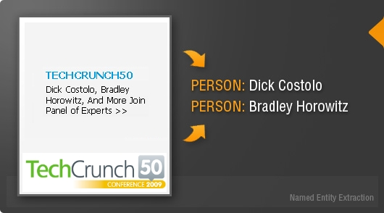
Entity Extraction
What is it:
Named entities specify things such as persons, places and organizations. AlchemyAPI's named entity extraction is capable of identifying people, companies, organizations, cities, geographic features and other typed entities from your HTML, text or web-based content.
How it works:
Entity extraction can add a wealth of semantic knowledge to your content to help you quickly understand the subject of the text. It is one of the most common starting points for using natural language processing techniques to enrich your content

Slide 37
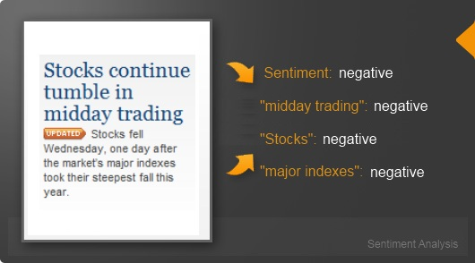
Sentiment Analysis API
What is it:
Sentiment is the attitude, opinion or feeling toward something, such as a person, organization, product or location. AlchemyAPI's sentiment analysis API provides easy-to-use mechanisms to identify the positive or negative sentiment within any document or webpage.
The sentiment analysis API is capable of computing document-level sentiment, sentiment for a user-specified target, entity-level sentiment, quotation-level sentiment, directional-sentiment and keyword-level sentiment. These multiple modes of sentiment analysis provide for a variety of use cases ranging from social media monitoring to trend analysis.
How it works:
AlchemyAPI's sentiment analysis algorithm looks for words that carry a positive or negative connotation then figures out which person, place or thing they are referring to. It also understands negations (i.e. "this car is good" vs. "this car is not good") and modifiers (i.e. "this car is good" vs. "this car is really good"). The sentiment analysis API works on documents large and small, including news articles, blog posts, product reviews, comments and Tweets.

Slide 38
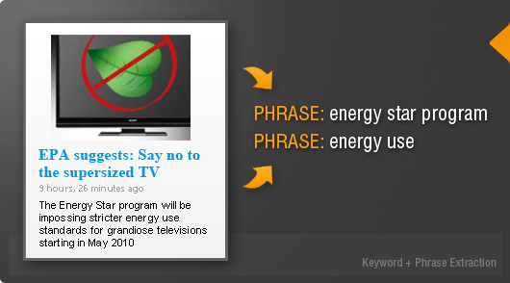
Keyword Extraction
What is it:
Keywords are the important topics in your content and can be used to index data, generate tag clouds or for searching. AlchemyAPI's keyword extraction API is capable of finding keywords in text and ranking them. The sentiment can then be determined for each extracted keyword.
The keyword extraction API works on URLs, HTML documents and plain text. Just like every other feature, AlchemyAPI automatically detects the language of the content and then performs the appropriate analysis.
How it works:
AlchemyAPI's keyword extraction algorithm employs sophisticated statistical algorithms and natural language processing technology to analyze your content and identify the relevant keywords. Keyword extraction is supported in over a half-dozen different languages, enabling even foreign-language content to be categorized and tagged.

Slide 39
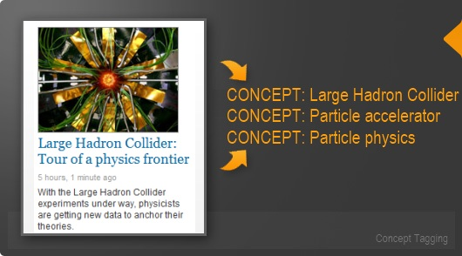
Concept Tagging
What is it:
AlchemyAPI employs sophisticated text analysis techniques to concept tag documents in a manner similar to how humans would identify concepts. The concept tagging API is capable of making high-level abstractions by understanding how concepts relate, and can identify concepts that aren't necessarily directly referenced in the text.
How it works:
if an article mentions CERN and the Higgs boson, it will tag Large Hadron Collider as a concept even if the term is not mentioned explicitly in the page. By using concept tagging you can perform higher level analysis of your content than just basic keyword identification.
.

Slide 40
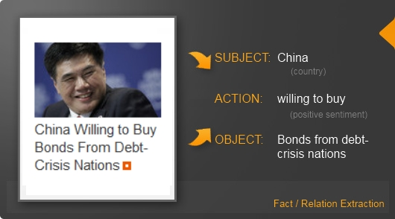
Relationship Extraction
What is it:
Relations are the subject, action and object relations within sentences. AlchemyAPI's relation extraction API is capable of parsing sentences into subject, action and object form and then adding additional semantic information such as entity extraction, keyword extraction, sentiment analysis and location identification
How it works:
Relation extraction can be used to automatically identify buying signals, key events and other important actions
.

Slide 41
Taxonomy
What is it:
AlchemyAPI automatically categorizes your text, HTML or web-based content into a hierarchical taxonomy. Using complex statistics and natural language processing technology, the taxonomy API can classify your content into its most likely topic category up to five levels deep.
How it works:
Deeper levels allow you to classify content into more accurate and lucrative subsegments. For instance, an application focused on identifying content discussing personal lending practices can narrow its classification into sub topics that target decisions with finer resolution.
.
/finance/personal finance/lending/credit cards /finance/personal finance/lending/home financing /finance/personal finance/lending/personal loans /finance/personal finance/lending/student loans /finance/personal finance/lending/vehicle financing

Slide 42
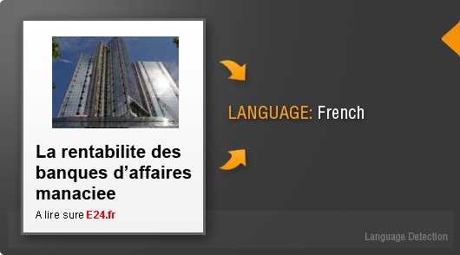
Language Detection
What is it:
provides a robust language detection facility capable of detecting the language of any text, HTML or web-based content. AlchemyAPI identifies more languages than any other text analysis service at extremely high rates of accuracy.
How it works:
With language detection, you can easily categorize or filter any content based on the language it was written in.
.

Slide 43
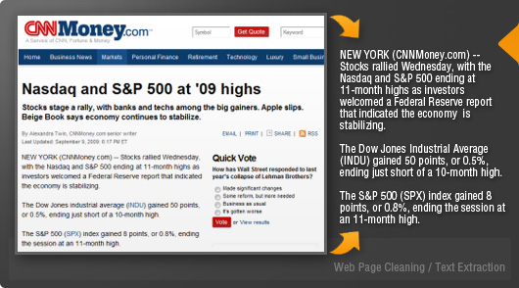
Text Extraction
What is it:
Can automatically extract the important information from a webpage, removing navigation links, advertisements and other undesired content. Use AlchemyAPI's text extraction API to just focus on the key text to improve website indexing, increase contextual advertising relevancy and simplify analysis.
How it works:
Text extraction can return the embedded links within the important content, which makes it possible to use for web crawling applications.
.

Slide 44

Microformats Parsing API
What is it:
Microformats are included in the HTML of webpages to add semantic information. These microformats allow the webpage to be more easily scanned and processed automatically through software. They are typically used for contact information, geographic coordinates, license information and similar information. AlchemyAPIs microformat parsing API can automatically detect and parse the microformats embedded within a webpage.
How it works:
Use microformat parsing to enhance webpage categorization and indexing and to perform content discovery tasks.
.

Slide 45

Feed Detection
What is it:
Feeds are often embedded into websites to allow visitors and automated feed readers to access syndicated content. AlchemyAPI's feed detection API can find the feeds within webpages and return the links.
How it works:
Use feed detection to discover new content, including blog posts, news articles and comment streams
.

Slide 46
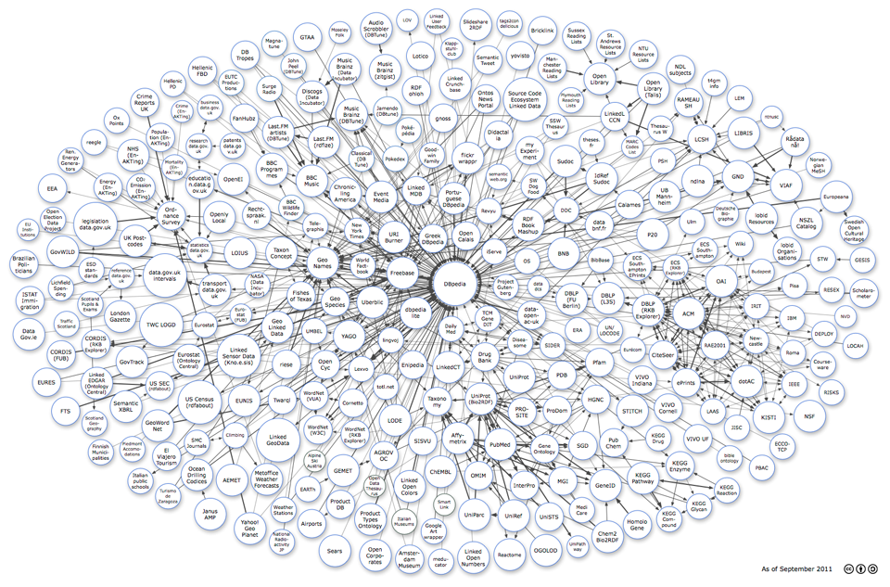
Linked Data
What is it:
Linked Data is a method of exposing, sharing and connecting data on the web via dereferenceable URIs. Linked Data aims to extend the Web with a data commons by publishing various open datasets as RDF on the Web and by setting RDF links between data items from different data sources
How it works:
if Apple, Inc. is identified as an entity in your content, using Linked Data makes it possible to get the following information: number of Apple employees, number of worldwide Apple locations, or last year's Net Operating Income. If AlchemyAPI finds a member of Congress in the content, linked data can access his or her picture, birth date, party affiliation, alma Mater or successor. The possibilities are endless.

Slide 47
Watson Services - not included in prior slides

Slide 48
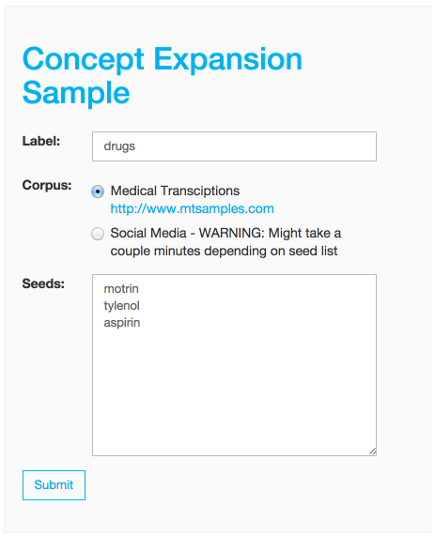
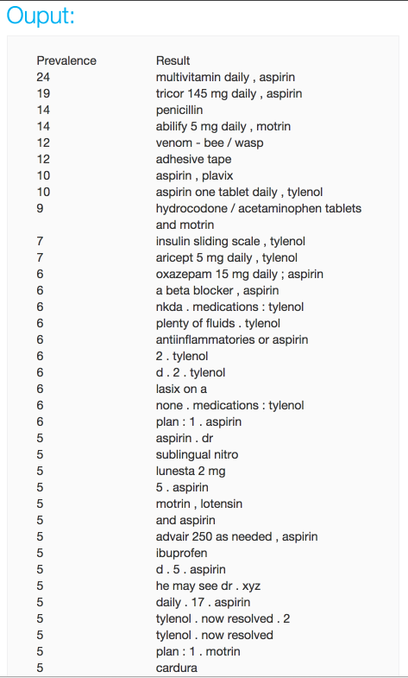
Concept Expansion
What is it?
Maps euphemisms or colloquial terms to more commonly understood phrases
How does it work?
Analyses text and interprets its meaning based on usage in other similar contexts.
Use Cases-
Example: interprets “The Big Apple” as meaning “New York City”.
Notes:
How does it work?
The Concept Expansion service analyses text and interprets its meaning based on usage in other similar contexts. For example, it could interpret “The Big Apple” as meaning “New York City”. It can be used to create a dictionary of related words and concepts so that euphemisms, colloquialisms, or otherwise unclear phrases can be better understood and analyzed.
Use Cases
Can be used to expand drug types

Slide 49

Document Conversion
What is it?
API based solution to convert documents with input format (PDF, Word, HTML) to output formats (HTML, Text, JSON needed for other Watson Services) synchronously or in a batch
How does it contribute to cognitive computing?
Automatically converts customer documents in varied formats to the format necessary for consumption by Watson services (training, data)
How does it work?
Users uploads documents in any supported format, chooses output format, and calls the API to perform the conversion
Example Use Cases
Company bulk imports corporate training material documents to train Watson services such as Retrieve and Rank and NLC
•
•
•
•
Notes:
Add link to bluemix page before submitting

Slide 50
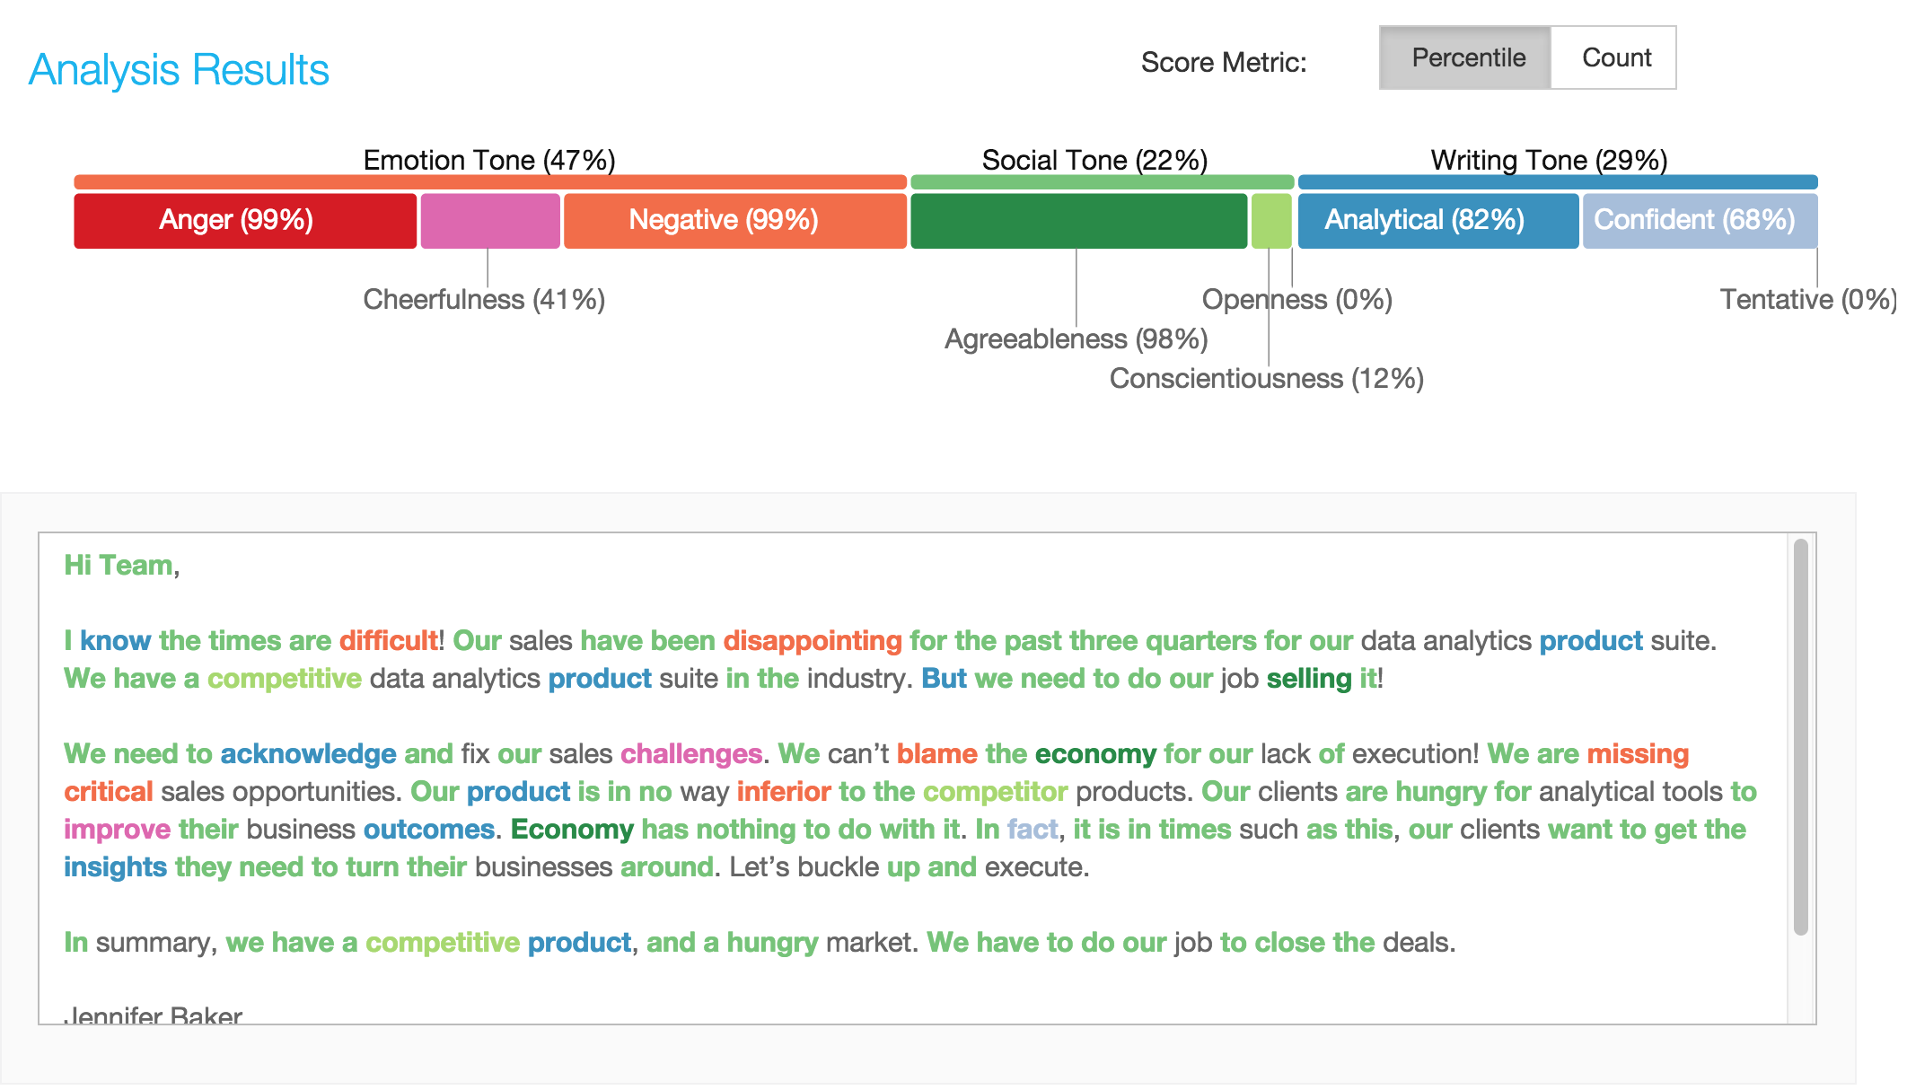
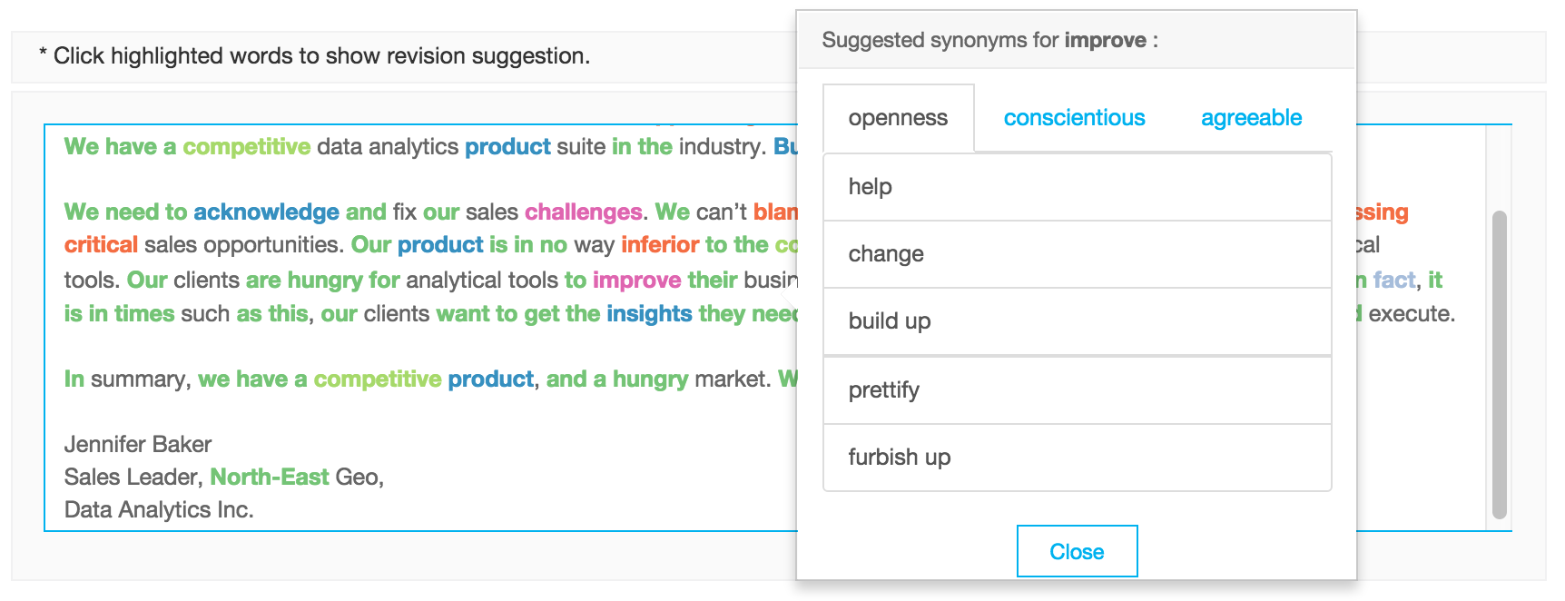
Tone Analyzer
What is it?
The Tone Analyzer service uses linguistic analysis to detect emotional tones, social propensities, and writing styles in written communication. Then it offers suggestions to help the writer improve their intended language tones.
Why is it unique?
Provides user with three tones (Emotional, Social and Writing tone) allowing a user to refine a message on three dimensions
How does it work?
Takes input as written text in English and provides output of the three tones as a JSON file.
Example Use Cases
Call Centers - Chat
Personal and Business Communication
•
•
•
•
Notes:
Add link to bluemix page before submitting

Slide 51
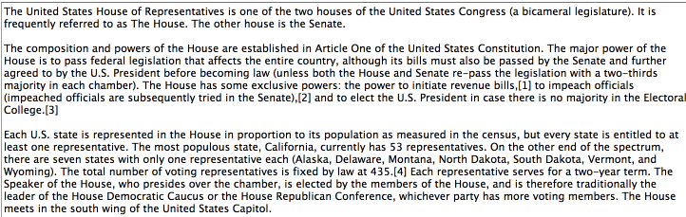
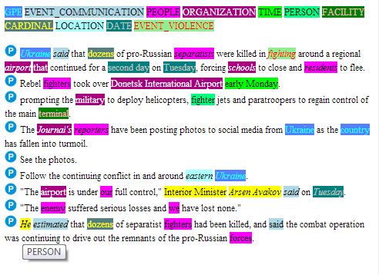
Relationship Extraction
What is it?
Intelligently finds relationships between nouns, verbs, subjects, objects, etc.
How does it work?
Parses sentences into their various components and detects relationships between the components.
Use Cases-
News article analysis to extract relevant people, organization, event type, date/time, or location
Notes:
3 mentions in yellow refer to the same person; so that you can infer that Avakov estimated the number of killed.
How does it work?
Parses sentences into their various components and detects relationships between the components. It can process new terms (like people's names in a news feed) it has never analyzed before through contextual analysis. Sentence components include parts of speech (noun, verb, adjective, conjunction, etc.) and functions (subjects, objects, predicates, etc.). The service maps the relationships between the components so that users or analytics engines can more easily understand the meaning of individual sentences and documents.
Use Cases-
The service can analyze a news article and pull out the relevant people, organization, event type, date/time, or location of actions taken. It then can relate the components such as what adjective describes what noun and what action a subject takes upon what object.

Slide 52
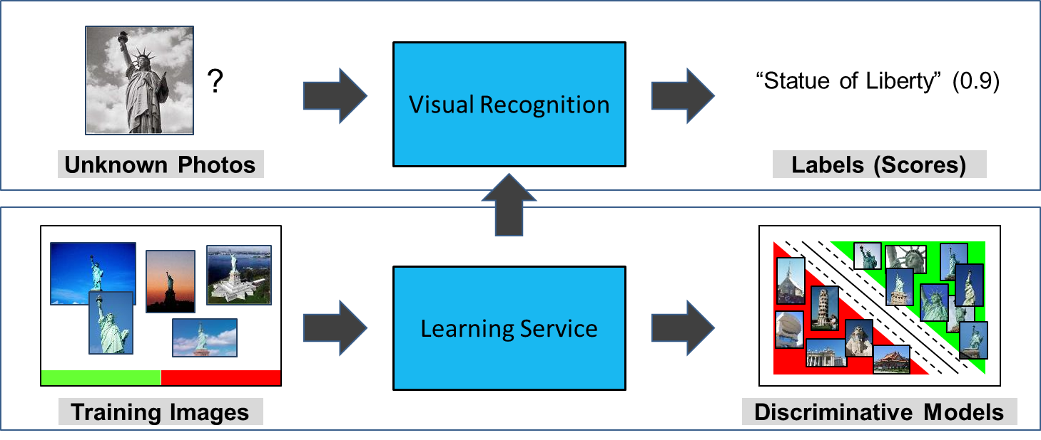
Visual Recognition
What is it?
Analyzes analyzes the visual appearance of images or video frames to understand what is happening in a scene.
How does it work?
Includes an unmatched number of preset classifier and trained labels (2,000+), a taxonomy that recognizes 150+ different sports, and can ingest 1,000+ batch images with the ability to recognize multiple labels in a picture.
Example Use Cases
Audio-visual indexing and search of media archive
Automatic “Smart Album” generation
Marketing data analysis from social media - For e.g., mine Pinterest images and perform segmentation

